Slide 1

Student Loan Analysis
Author: MARk liang
Contributing: Martin W.

Slide 2
Question 1:
To what degree does the type of school (4-year public, 4-year for private, 4 year not for profit) drives the amount of student loans that undergrads would receive?

Slide 3
Question 2:
Is there a relationship between the average amount of loans received by a student and their overall graduation rate?

Slide 4
National center for education statistics (NCES)
“The National Center for Education Statistics (NCES) is the primary federal entity for collecting and analyzing data related to education in the U.S. and other nations. NCES is located within the U.S. Department of Education and the Institute of Education Sciences. NCES fulfills a Congressional mandate to collect, collate, analyze, and report complete statistics on the condition of American education; conduct and publish reports; and review and report on education activities internationally.”
https://nces.ed.gov/about/

Slide 5
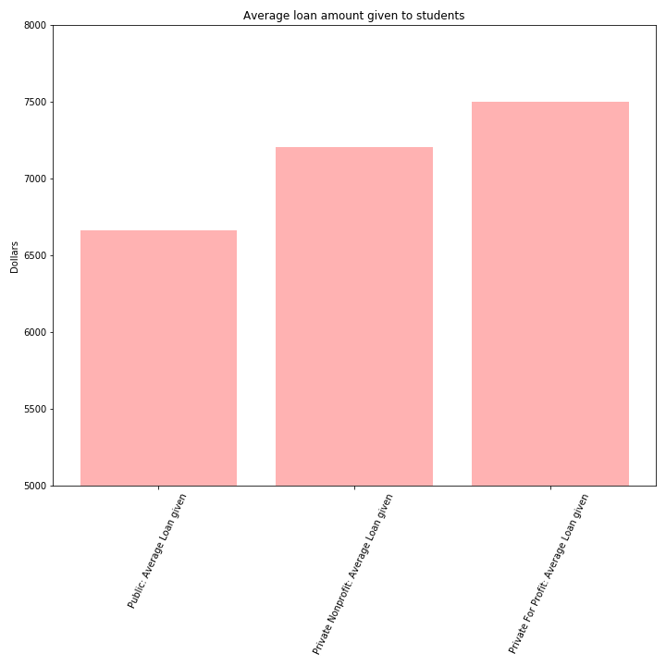


Slide 6
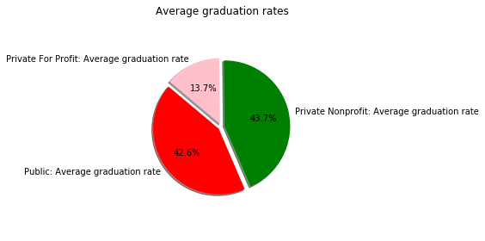

Slide 7
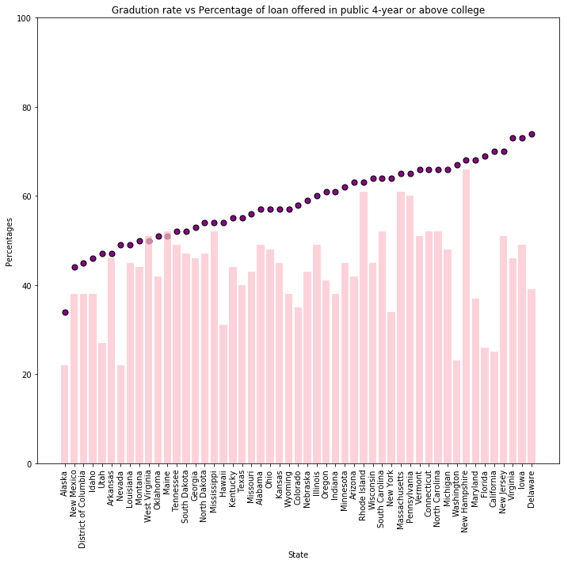
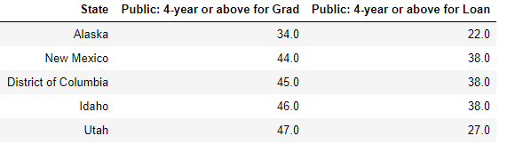
Public 4-year colleges

Slide 8
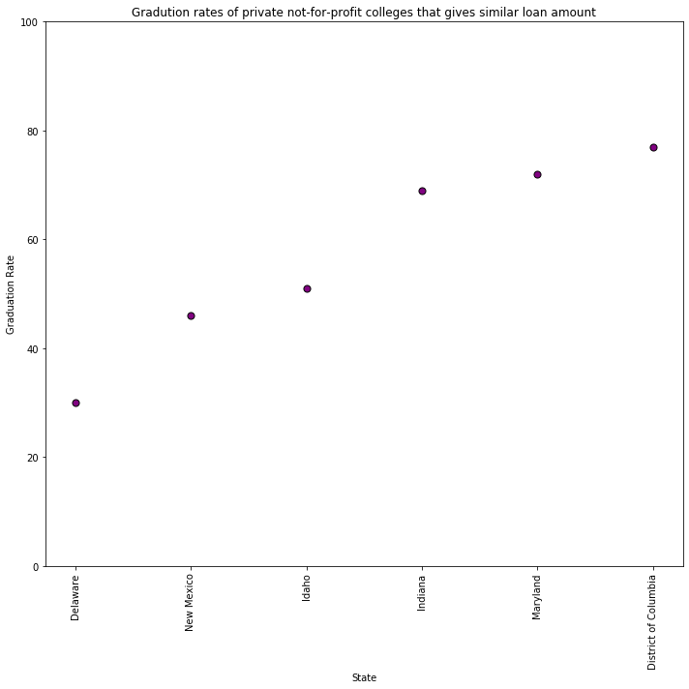
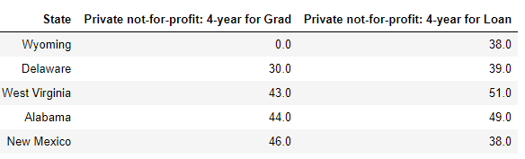
Specific states with similar loan amounts

Slide 9
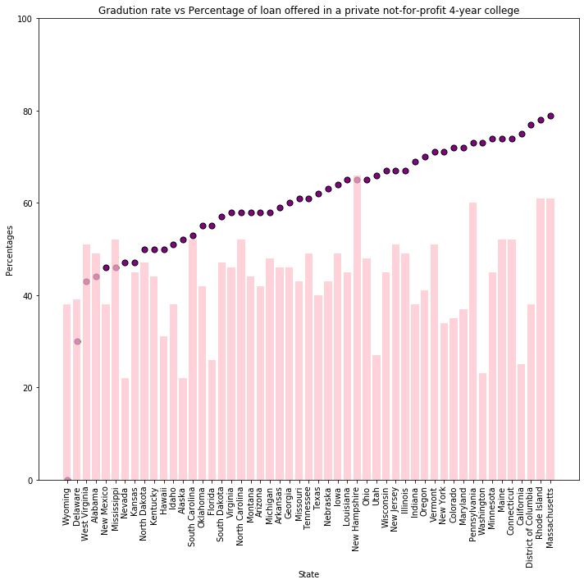
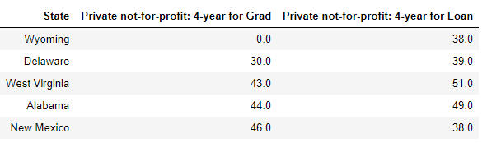
Private Not for profit 4-year colleges

Slide 10
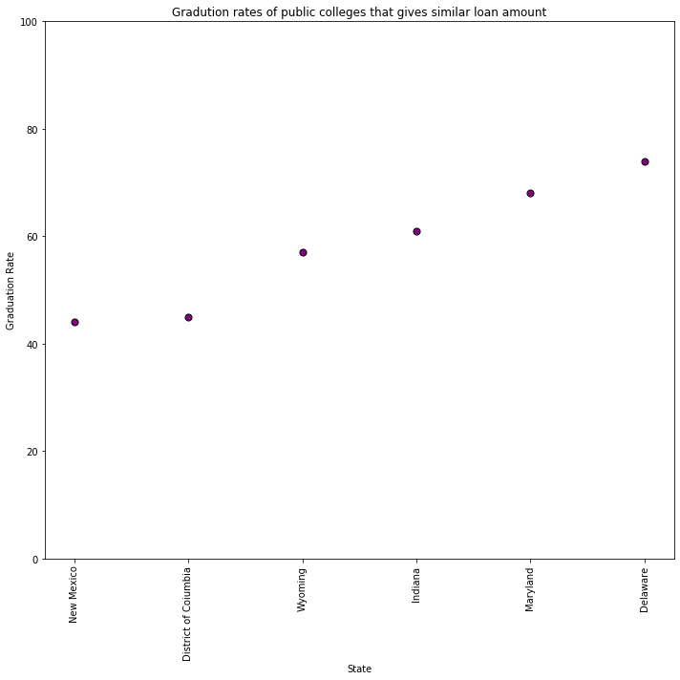
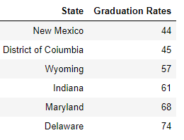
Specific states with similar loan amounts

Slide 11
Comparison

Slide 12
Questions?

Slide 13
Thank you!

